Slide 1

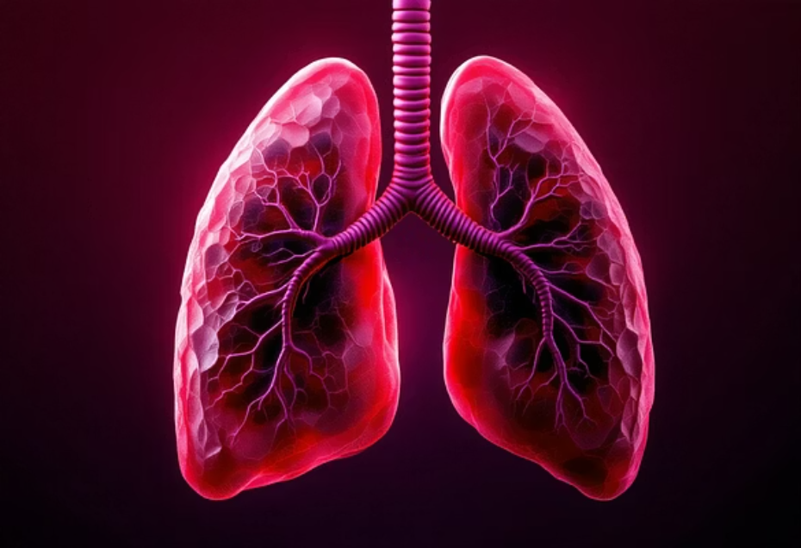
🌍 The Global Challenge of Air Pollution
Human Cost is Severe
Lack of Proactive Systems
Reactive Policy Cycles
Approximately 7 million premature deaths annually are directly linked to ambient (outdoor) and household air pollution, according to the WHO (2024).
Decision-makers are often forced to intervene after severe pollution events have already occurred, limiting effective environmental mitigation.
Many developing cities rely on static monitoring. They critically lack sophisticated, predictive air-quality systems necessary for preventative action.

Slide 2
🌿 GreenPulse: AI for Climate Action
"AI can be the bridge between innovation and sustainability." — UN Tech Envoy
Forecasting Tomorrow's Air Quality with Machine Learning
Anne Atieno | PLP Academy.

Slide 3





💡 GreenPulse: An AI-Powered Solution
GreenPulse provides urban planners and policymakers with a critical tool for environmental management.
Predictive Power
SDG Alignment
AI-driven model forecasts next-day fine particulate matter (PM2.5) concentrations.
Directly supports SDG 13 (Climate Action) by translating raw data into actionable, real-time insights.
Key Inputs
Visualization
Prediction based on diverse datasets, including hyper-local weather and traffic flow patterns.
Utilizes Streamlit for an accessible, interactive, and user-friendly visualization dashboard.

Slide 4




⚙️ The GreenPulse Workflow
We employ a robust Machine Learning pipeline to transform raw data into clear, predictive insights.
Data Acquisition
Model Training
Collect and clean diverse time-series data: weather conditions, traffic volume, and historical air quality metrics.
Train a Random Forest model, leveraging its robustness against noise and non-linear data patterns.
PM2.5 Prediction
Actionable Dashboard
The trained model generates a precise forecast of the next 24 hours' PM2.5 concentration levels.
Visualize the results instantly via a responsive Streamlit dashboard for stakeholder decision-making.

Slide 5

📊 Model Performance Metrics
The GreenPulse model demonstrates high accuracy, reliably forecasting critical air quality trends needed for proactive urban management.
4.2
5.6
0.88
MAE (Mean Absolute Error)
RMSE (Root Mean Square Error)
R² (Coefficient of Determination)
The average difference between predicted and actual PM2.5 values is minimal, measured in µg/m³.
Low RMSE indicates the model avoids large errors, ensuring high prediction fidelity.
This strong R² value shows the model explains 88% of the variability in the air quality data.
✅ The results confirm the Random Forest model's ability to accurately capture and predict complex air quality dynamics, validating its use for urban planning.

Slide 6

⚖️ Ethics, Transparency, and Impact
Privacy by Design
The model strictly utilizes only public environmental, traffic, and meteorological data. No personal identifying information is collected or processed.
Promoting Fairness
The system is designed for transparency, ensuring equitable access to predictive insights across different city sectors and populations.
Enabling Proactive Action
By providing a 24-hour lead time, GreenPulse allows for strategic interventions like traffic re-routing or temporary industry restrictions, reducing public health exposure.

Slide 7
🚀 Future Roadmap: Scaling GreenPulse
Our next steps focus on enhancing data integrity, model performance, and accessibility.
Advanced Model Comparison
Real-Time Data Integration
Conduct rigorous comparative analysis of Random Forest versus the high-performance XGBoost algorithm for optimization.
Shift from static data ingestion to live API feeds for immediate and highly accurate forecasting.
Public Alert System
Platform Deployment
Develop an automated notification system, such as SMS alerts, for the public during predicted high-pollution events.
Deploy the Streamlit dashboard on a stable, scalable platform (Streamlit Cloud or Vercel) for 24/7 access.

Slide 8


🎯 Call to Action
Forecast Tomorrow's Air — Today!
GreenPulse provides concrete evidence that AI can transform complex climate data into actionable, life-saving policy decisions.
GreenPulse is a vital example of AI for Sustainable Development.
This technology empowers city planners to protect public health and the environment proactively.
"Data-driven hope is the cleanest air we can breathe."
Let’s collaborate to deploy and scale this solution in vulnerable urban areas.
📧 Anne Atieno | 🌐 github.com/AnneAtieno/GreenPulse
💬 #AIforGood | #SDG13

